Slide 1






Let’s Talk Business

Slide 2
Name
Title
Company
Notes:
It’s time to introduce yourself!

Slide 3




At the heart of every business is …
People
Products
Service
Marketing
Notes:
What would you say if I asked you what is at the heart of every business? Would you say it’s the people? Products? Service? Their marketing? Anything I’m missing here?

Slide 4

Money!
Notes:
It’s money! Every business wants to turn a profit to stay in business. Even nonprofits have their eye on the money. Who manages the money? Accountants! Accountants know what it takes to help make a business financially successful.

Slide 5

CPA or accountant?
CPA stands for Certified Public Accountant.
CPAs are accountants, but accountants are not necessarily CPAs.
If you're a CPA, you:
Earn more money throughout their career.
Garner more trust and respect.
Experience greater job security.
Can become even more specialized.
Take on highly valued, consulting roles.
Notes:
While all CPAs are accountants, not all accountants are CPAs. CPAs are accountants who are certified. CPA stands for Certified Public Accountant. A CPA is a trusted adviser to individuals, businesses, and other organizations, helping each achieve their financial dreams and goals. Whether advising businesses on multi-million-dollar acquisitions, auditing companies’ 401K plans, or helping people investment for retirement, a CPA’s adherence to a strict code of ethics along with accounting and finance expertise allows the public to put their trust in CPAs.
To become a CPA, they had to meet their state’s experience and education requirements and pass the CPA Exam.

Slide 6

A CPA story
I first became interested in accounting when …
My career started …
And now I … Which means I ...
My favorite part of my job is …
The coolest thing I’ve done as a CPA is …
You might be surprised to learn I …
Notes:
It’s time to introduce yourself and share your story! The bullet points are available as prompts to share why you chose accounting and your journey thus far.
**Update this slide with bulleted information you would like to share.

Slide 7
What are you looking for in a future career?
Notes:
So let me ask you this. Have you thought about what are you looking for in a future career? <ask the students>
If they answer: What if I told you that you could do all of that with accounting?
If they don’t answer, ask: Who has the coolest job in your family?... Why?
Presenter Tip: A student might answer here that they are interested in becoming an artist, or something unrelated to business or accounting. No matter the career a student may say they want to pursue, point out how a background in accounting can help them. For example, as an artist you want to make sure that you’re bringing in more money than you’re spending on supplies in order to continue pursuing your passion. Learning about accounting and how businesses work will help you succeed in your career.

Slide 8








Money
Owning a Business
Traveling
Making an Impact
Teaching
Work/Life Balance
Professional Growth
Job Security
Notes:
Whether you’re interested in making money, owning a business, traveling, or making an impact in the world, Accounting can give you that and more! Let’s explore a few of these. Where would you like to start?
Presenter Tip: Click on an icon to advance to that slide and learn more. From there, click on the back arrow to take you to back to this slide, where you can choose another option. When you’re ready to advance the presentation, click the forward arrow above.

Slide 9
Accounting is money.
Notes:
Accountants are the backbone of the business world and keep finances in check – for everyone. No matter the size of the company, accountants help organizations meet their goals by protecting financial resources.

Slide 10
Follow your passion.
“Spending a few years working in an accounting role for a firm or industry can be wonderful training for future entrepreneurs. They get to see first-hand how businesses operate and are financed and learn other important lessons that will help them succeed as they launch their own companies.” – Jerry Maginnis, CPA
Notes:
Own a business where your passion lies. As a CPA, you’ll help ensure its financial success.
If you’re interested in owning your own business and being your own boss, consider majoring in accounting. You’ll have the financial know-how to ensure your company is a success!

Slide 11
Travel the world.
Notes:
CPAs meet their clients where they are. That means opportunities for travel for you!
In addition to travel, accounting careers provide work flexibility, with many companies offering the ability to work remotely, even worldwide!
Presenter Tip: If you have had the opportunity to travel for work, share your experience here!

Slide 12
Make an impact.
Notes:
The new field in accounting is ESG: environmental, social and governance. Think carbon emission and climate change. Accountants ensure companies are complying with federal laws and regulations that hold them accountable to the world around them.
Accountants can also give back to their community by helping their favorite charity make every dollar count.

Slide 13
Share your knowledge.
Notes:
Whether tutoring, teaching, or being a consultant for a large company, there are many individuals that can benefit from a conversation with an accountant.

Slide 14
Make it balance.
Notes:
We’re not talking about the balance sheet this time.
Accountants work hard, but that hard work affords them the ability to take well deserved time off too!
Presenter Tip: Share a positive personal story of the lifestyle/flexibility being a CPA has afforded you.

Slide 15
Grow professionally.
Notes:
Your career growth is in your hands. As a CPA you can go into any industry and change your path at any time. As the world changes and businesses evolve, there are many opportunities for training and growth.

Slide 16

Feel secure.
“Accounting is solid. You can always get a job as a CPA.” — Colleen Conrad, National Association of State Boards of Accountancy (NASBA)
Notes:
As an accounting graduate, you will always be in demand and are afforded a clear career path with advancement opportunities.

Slide 17

Accountants work with data and people. They drive business decisions and strategy.
Typical responsibilities
Help companies thrive in times of uncertainty.
Ensure organizations are environmentally and socially responsible.
Communicate information to business owners and investors.
Advise clients on taxes.
Implement new accounting technologies and systems.
Investigate potential fraud.
Analyze financial reports to evaluate business performance.
Notes:
Highlight some of the responsibilities.

Slide 18
Accountants work in all types of organizations
Entrepreneur/ Start-Ups
Nonprofits
Companies of all Sizes
Governments
Sports & Entertainment
Accounting & Consulting Firms
1047 Games
Weav
Symbrosia
Habitat for Humanity
Smithsonian
World Central Kitchen
Apple
Ikea
Bank of America
Zappos
Everlight Solar
City Government
FBI
NASA
Military
NFL
TikTok
Disney
Netflix
Local
Regional
National
International
Notes:
As we’ve seen, accountants work in all types of organizations. Several of these names should look familiar to you.
Presenter Tip: Take a moment to highlight companies/industries specific to your state or area and explain how an accountant helps those companies. And add your own firm’s name above!
State Tip: Update the company names to highlight local start-ups, firms, etc.
Organizations listed above:
Start-Ups: 1047 Games, Weav (fintech startup), and Symbrosia (solving climate change) were all featured on Forbes 30 under 30
Nonprofits: Habitat for Humanity, Smithsonian and World Central Kitchen
Companies of all Sizes: Apple, Ikea, Bank of America, Zappos, Everlight Solar
Governments: Along with City Governments, there’s the FBI, NASA, and Military
Sports & Entertainment: NFL, TikTok, Disney (and the new Disney+) and Netflix
Accounting & Consulting Firms: Local, Regional, National and International

Slide 19


Accountants have many
Chief Financial Officer (CFO)
Tax Adviser
Forensic Accountant
opportunities
Owner/ CEO
Audit Manager
Financial Planner
Data Analyst
Notes:
These are just some of the job titles you could have as an accountant.
Presenter Tip: Share some of the various job titles you have held throughout your career, highlighting the progression or path changes you have made.

Slide 20




Could accounting be right for you?
Notes:
So, could accounting be right for you?
Do you want flexibility in your career?
Do you like puzzles?
Do you like technology?
Do you like working in teams?
Do you like helping people?
Do you like detective work?
Presenter Tip: Make this part interactive and ask the students to raise their hand for each question they relate to.
If this sounds like you, explore accounting!

Slide 21

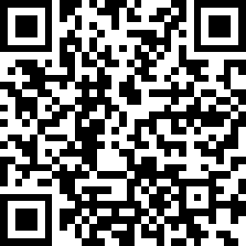

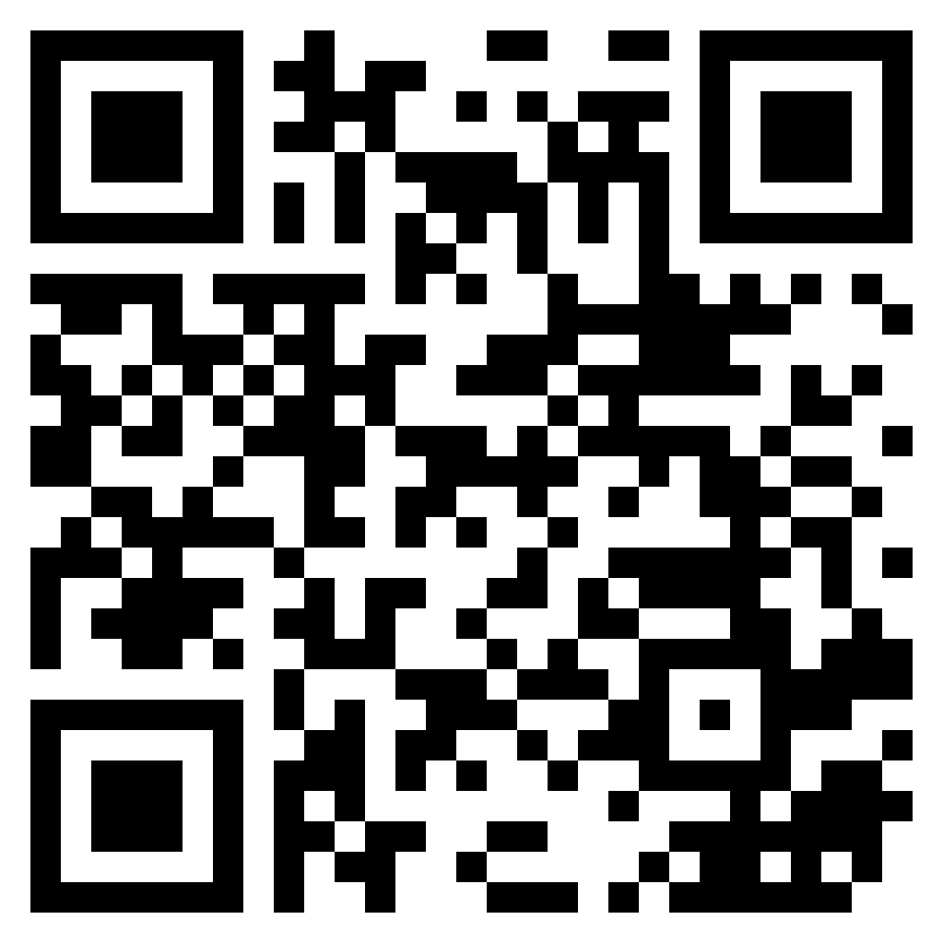
Learn more about accounting
Take an accounting class if available.
Write down your presenter’s information for future reference.
Discuss accounting with your career counselor.
Talk to the adults in your life – who do you know that is a CPA that you can shadow for a day?
Notes:
There are things you can do now to learn more about accounting.
Presenter Tip: If you’re willing, offer to help students with networking (explain what this entails – networking is a new concept for high school students) and connecting them with CPAs to learn more.

Slide 22
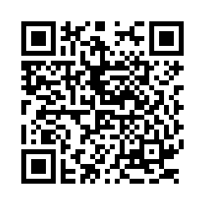

A few questions as we finish the presentation.
Notes:
We’d like to gauge students’ feelings on accounting following the presentation and ask that they complete a post-survey. The survey is voluntary, only 5 questions long and will take 1-2 minutes to complete. All you need to do is point the camera on their phone to the QR code on the screen and follow the link that comes up.
The following questions are asked:
How did this presentation affect your interest in accounting as a career?
What is the likelihood that you will pursue accounting as a major?
What is your high school graduation date?
What are your plans following high school graduation?
*Optional* If you would like to receive email updates from the AICPA on opportunities in accounting, scholarships, and free student membership, please provide your name and email address.

Slide 23

Questions?

Slide 24

Thank you
Presenter name
Email address
Website address
Notes:
Update this slide with your contact information as you close out the session. If you’re willing, suggest that students take down your information if they have any future questions.

Slide 25
Optional Activities
2-minute activities:
What kind of accountant are you? Quiz on accounting+
Video: Sweet Martha’s Cookie Jar
10-minute activity:
Jeopardy game
10–15-minute activity:
Shark Tank activity
Notes:
**Insert QR Codes to links
If time permits, engage in an activity with the students.
Quiz: Buzzfeed style, fun quiz from the CAQ. Students can complete and share their results.
Sweet Martha’s Cookie Jar video: https://www.youtube.com/watch?v=DeBATyIRCLw
Jeopardy: Link to online Jeopardy game
Shark Tank: Listen to a Shark-Tank clip of a pitch. The pitch will be one that wouldn’t generally be chosen. Students will advise what should be done to make the idea more profitable and something they would invest in.

